Slide 1
EDU ISV Hackathon
Overview
Questions: alias@microsoft.com

Slide 2
Agenda
Hack overview
Prerequisites for SSO integration
Sample application

Slide 3
At The End of the Hackathon
I am able to able to…
authenticate and run a graph API query(ies) for roster data in the MS Graph Explorer
provision my app into an O365 Edu tenant (with consent granted for access to roster data)
run a graph API query for roster data from the directory against an O365 Edu tenant

Slide 4
Demo-EDU Sample App
TJ Vering
http://edusampleapp.azurewebsites.net/

Slide 5
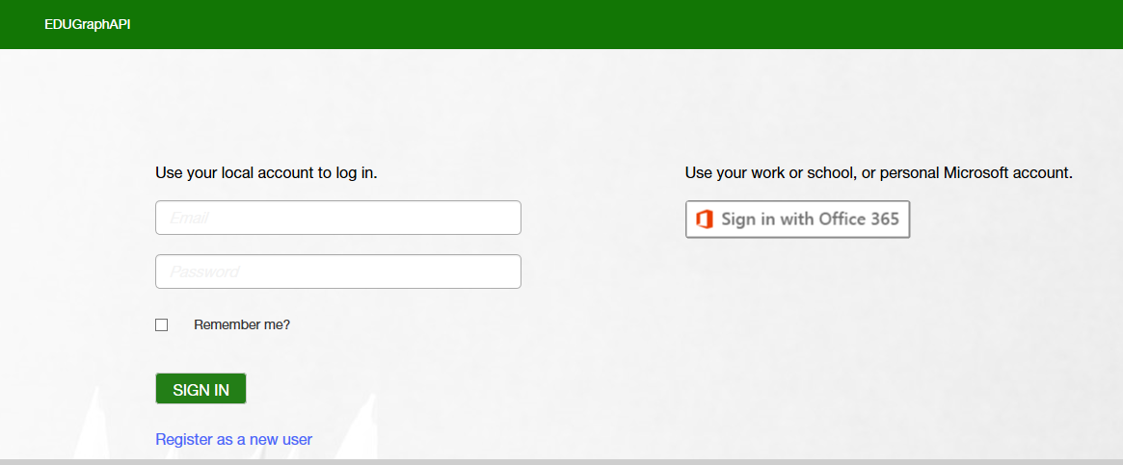
Sign In Screen

Slide 6
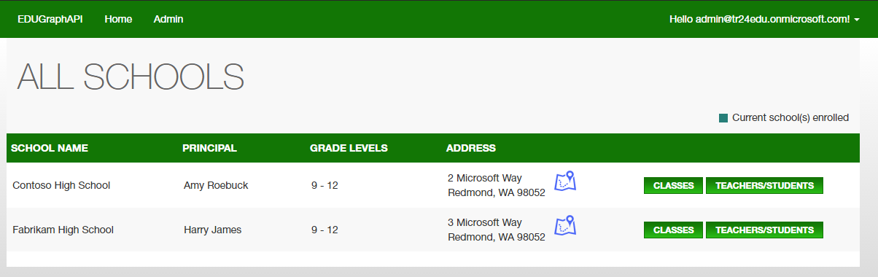
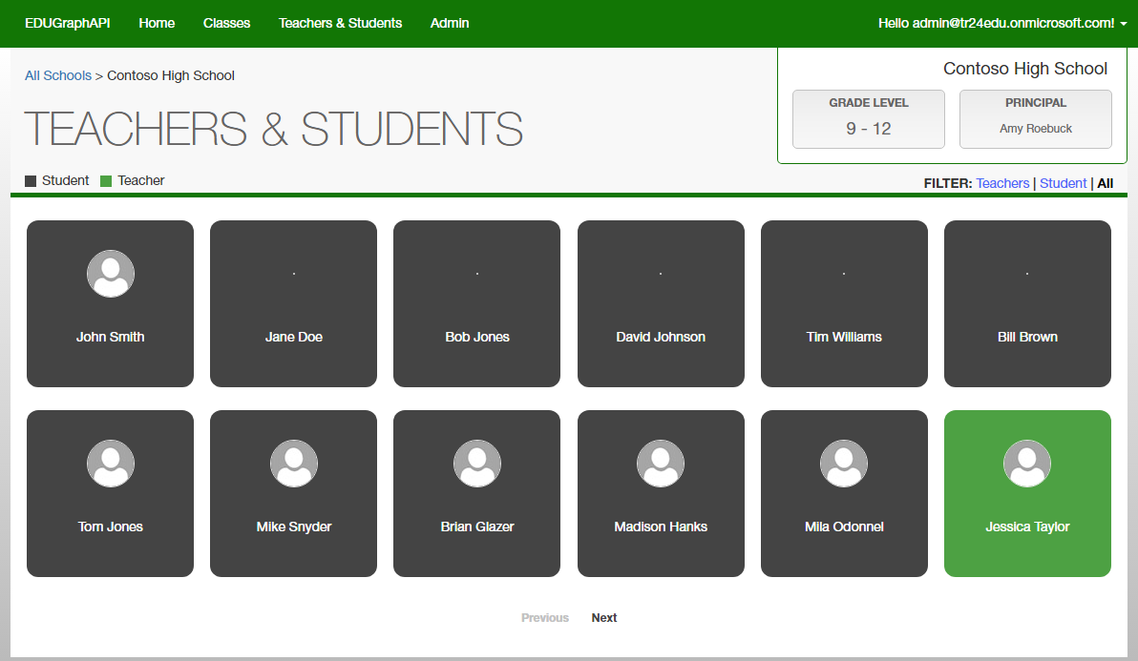
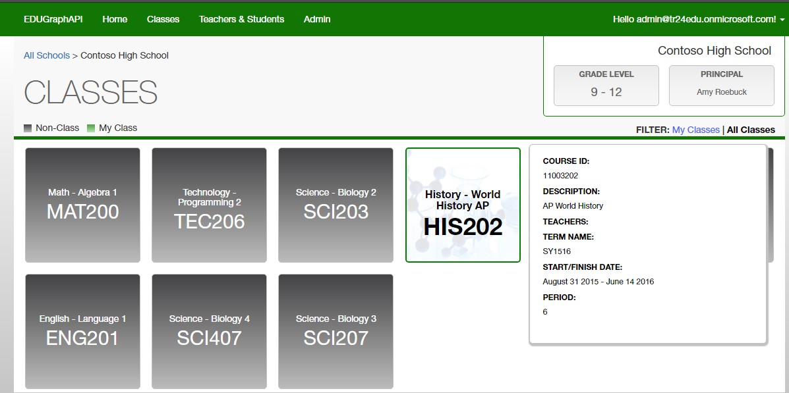

Slide 7
Action
Get GitHub IDs and add them to EDU repos
https://github.com/OfficeDev?utf8=%E2%9C%93&q=edu&type=&language=

